Slide 1
Cri-du-Chat Syndrome
By Christina Pham

Slide 2
What is Cri-du-Chat syndrome?
Cri-du-Chat syndrome is genetic disorder cause by a deletion (the length of which may vary) on the short arm of chromosome 5.
Its name is a French term (cat-cry or call of the cat) referring to the characteristic cat-like cry of affected children.

Slide 3
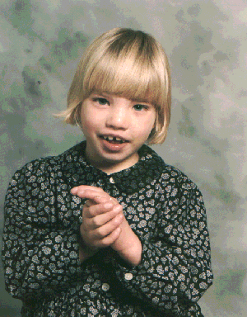
Affects and Symptoms
It affects between 1 in 20,000 and 1 in 50,000 babies.
Some symptoms of Cri-du-Chat is:
Having cat-like cries
Behavior problems
Widely set eyes
and small/round face.
This picture shows some of
the symptoms that are listed.

Slide 4
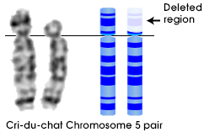
How do people get it?
A break in the DNA molecule that makes up a chromosome cause a deletion.
The chromosome break occurs while the sperm or egg cell is developing, in most cases.
The child will develop cri-du-chat syndrome, when this gamete is fertilized.
This picture shows the deleted regions in
Chromosome 5 pair.

Slide 5
Treated, Diagnosed, and Level
There is not really a real treatment for it.
But they can go through therapy to improve their language skills, motor skills, and to help them develop as normally as possible though.
It is possible to test for cri-du-chat while the baby is still in its mother's womb or through a tiny sample of tissue from outside the sac where the baby develops
It happens in Chromosome Abnormalities.
It is a Level 2.

Slide 6
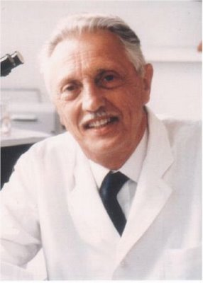
Interesting Facts
Jerome Lejeune ,a geneticist, identifie cri-du-chat syndrome in 1963. He also discovered the genetic abnormality that causes Down syndrome.
The chromosome carrying the deletion comes from the father's sperm rather than the mother's egg, in 80% of the cases.
Cri-du-chat is one of the most common syndromes caused by a chromosomal deletion.
This is a picture of Jerome Lejeune.

Slide 7
Citations
"CRI-DU-CHAT SYNDROME." Genetic Science Learning Center. N.p., 2012. Web. 6 Dec. 2012. <http://learn.genetics.utah.edu/content/disorders/whataregd/cdc/ index.html>.

