Slide 1
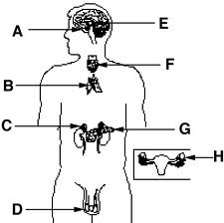
Name Endocrine System Diagram
Hypothalmus
Pituitary
Thyroid
Thalmus
Adrenal
Ovaries
Testes

