Slide 1
Williams Syndrome
By: Noah Lee

Slide 2
What is Williams Syndrome?
Williams syndrome is a syndrome that is very rare. It is affects a child's growth, physical appearance, and cognitive development. This happens because a child is missing material from chromosome 7 (gene elastin).
The gene elastin is the protein product that gives the blood vessels the stretchiness and strength to last a lifetime. The elastin can only be formed when a human is a child.

Slide 3
Symptoms
The symptoms of Williams syndrome are:
Mental retardation
Heart defects
Low birth weight
Failure to gain weight appropriately
Kidney abnormalities
Low muscle tone
Characteristic behaviors; such as hypersensitivity to loud noises and an overly outgoing personality
Unusual facial features:
Small upturned nose
Wide mouth
Full lips, small chin
Widely spaced teeth

Slide 4
How Does it Happen?
Williams syndrome happens when there is a break in the DNA of chromosome 7. Usually the break in the DNA occurs when the male and female gametes are forming. The child will form Williams syndrome when this gamete is fertilized.
If the parent has another child, it is unlikely for that child to get the syndrome. Since most people who have the syndrome do not have children, it is unlikely, but possible for a child to inherit the broken chromosome.

Slide 5
How is it Diagnosed?
To identify Williams syndrome, doctors use its physical appearance.
They use a technique called F.I.S.H. This technique allow the DNA sequences to be labeled with a fluorescent chemical. The chemical is called a probe. This chemical lights up when exposed to the ultraviolet light.
The gene elastin, after it is labeled with probe will only light up if it is present. This is how doctors tell that Williams syndrome is present.

Slide 6
How is it Treated?
Williams syndrome does not have a cure yet, so the patients have to be monitored continually.

Slide 7
Interesting Facts
Only 1 out of every 10,000 babies is born with Williams syndrome.
The deletion in the DNA is too small even to be seen under a microscope.
Williams syndrome is known to occur equally in both males and females and in every culture.

Slide 8
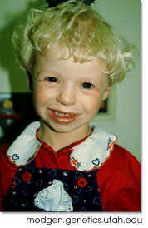
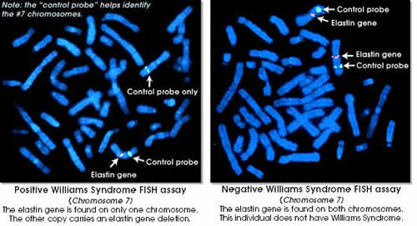
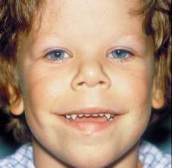
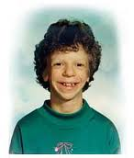
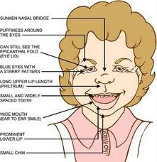
Pictures

