Slide 1
Smith-Lemli-Opitz syndrome
By Fiona Schaeffer

Slide 2
You need to know for this Power Point:
This Bullet point means take note of this
This bullet point means you do not need to take note of this.
Italicized, bolded, and underlined words or phrases are something that might want to be copied down.

Slide 3
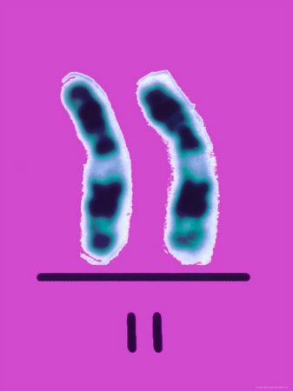
Chromosome 11
Smith-Lemli-Opitz syndrome is a genetic disorder that results in mutation of chromosome number 11. Specifically the mutation occurs in the DHCR7 (7-dehydrocholesterol reductase) of chromosome 11. This gene codes for an enzyme that is involved in the production of cholesterol. People who have SLOS are unable to make enough cholesterol to support normal growth and development

Slide 4
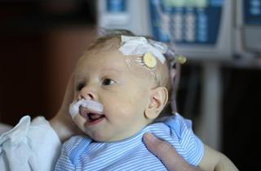
What SLOS Causes
Baby with SLOS.
People who have SLOS are unable to make enough cholesterol to support normal growth and development.
The problem with this is that the body needs a certain amount of cholesterol or the body’s growth is weak and mental retardation can occur.

Slide 5
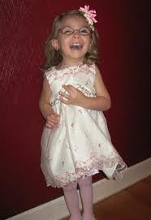
symptoms
Symptoms are different for everyone who has SLOS, because everyone who has SLOS produces a different amount of cholesterol. (This means symptoms depend on the amount of cholesterol a person produces.)
A few symptoms are: mental retardation, a cleft palate, and extra fingers and/or toes (polydactyly)
Other symptoms that may only occur at birth are: webbing between 2nd and 3rd toes, or an abnormally small head.
This is what SLOS looks like

Slide 6
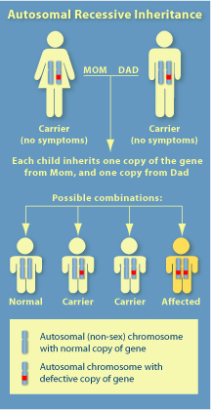
How do you get SLOS?
This genetic disorder follows a recessive pattern. If both your parents have this genetic disorder as carriers, there is a 25% chance that you will get SLOS. It would be the same for any of your siblings. If only one of your parents is a carrier you cannot get Smith-Lemli-Opitz syndrome, but you become a carrier.
Pedigree Chart for Smith-Lemli-Opitz syndrome.

Slide 7
More About SLOS
Smith-Lemli-Opitz Syndrome is called a Single Gene Disorder. It is considered a level one genetic disorder. http://learn.genetics.utah.edu/content/disorders/whataregd/ says that single gene disorders are “disorders that result when a mutation causes the protein product of a single gene to be altered or missing.”

Slide 8
Diagnose
There are many ways to diagnose Smith-Lemli-Opitz syndrome.
Some examples are:
Blood tests can be taken to see if you have Smith-Lemli-Opitz syndrome.
Other scans/tests can be given to determine deformities. (ex. ultrasound )
CVS (chorionic villus sampling) is another way to test for SLOS.

Slide 9
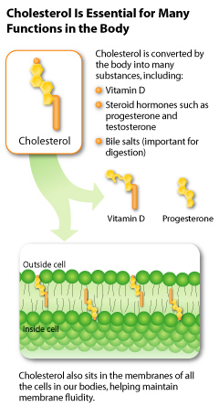
Treatment
There is no treatment to cure SLOS.
Although people with Smith-Lemli-Opitz Syndrome can receive cholesterol supplements to improve growth.
People with SLOS also can receive surgeries to fix deformities, such as a cleft palate
Cholesterol Chart

Slide 10
Interesting Facts
1 in 20,000 children are estimated to get SLOS. (Ratio: 1:20,000)
Originally called and sometimes still called RSH (named after the first three patients with it.)
It was first observed in 1964
SLOS was named after the three men who first observed it. There names were David Smith, Luc Lemli, and John Opitz.

