Slide 1
Overview of the Six Kingdoms

Slide 2
Vocabulary
Which term means one-celled? Many-celled?
multicellular
unicellular
Which term means that the organism produces its own food? Consumes food?
autotroph
heterotroph

Slide 3
Vocabulary
Prokaryotic – describes an organism with cells that have a cell membrane but do NOT have a nuclear membrane
Eukaryotic – describes an organism with cells that have a cell membrane and a nuclear membrane

Slide 4
Vocabulary
Autotrophic – makes its own food
Heterotrophic – gets nutrients from the food it consumes

Slide 5
List of the Six Kingdoms
Kingdom Eubacteria
Kingdom Archaebacteria
Kingdom Protista
Kingdom Fungi
Kingdom Plantae
Kingdom Animalia

Slide 6
Kingdom Eubacteria
Bacteria can live in many places on earth, inhabiting a wide variety of habitats, including other organisms
Unicellular
Prokaryotic
Autotrophic or heterotrophic
Thick cells walls with peptidoglycan

Slide 7
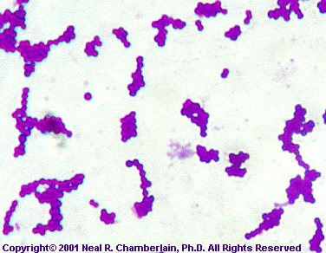
Kingdom Eubacteria
Bacteria come in different shapes, such as round, spiral and rod-shaped.

Slide 8
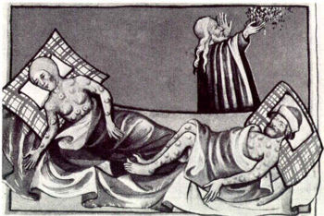
Kingdom Eubacteria
Bacteria can cause a wide variety of diseases, such as strep throat, food poisoning and the Black Death (bubonic plague of the Middle Ages)

Slide 9
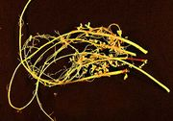
Kingdom Eubacteria
Bacteria also play an important role in decomposition, nitrogen fixation and human digestion (E. coli)
Soybean root containing billions of bacteria

Slide 10
Kingdom Archaebacteria
Bacteria that live in extreme habitats, such as hot springs, geysers, volcanic hot pools, brine pools, black smokers
Unicellular
Prokaryotic
Autotrophic or heterotrophic
Cell walls without peptidoglycan

Slide 11
Kingdom Archaebacteria
Morning Glory Pool in Yellowstone National Park – note the bright colors from the archaebacteria growing in the extremely hot water.

Slide 12
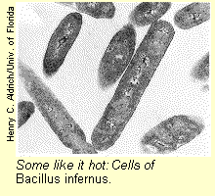
Kingdom Archaebacteria
Some like it hot! Bacillus infernus

Slide 13
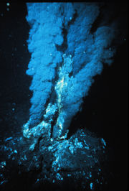
Kingdom Archaebacteria
Archaebacteria can live deep in the ocean near geothermal vents called black smokers
There is no light, so they carry out chemosynthesis instead of photosynthesis

Slide 14
Kingdom Protista
Extremely diverse group
Eukaryotic
Most unicellular, some colonial, some multicellular
Autotrophic and heterotrophic
Some with cell walls containing cellulose; some carry out photosynthesis with chloroplasts

Slide 15
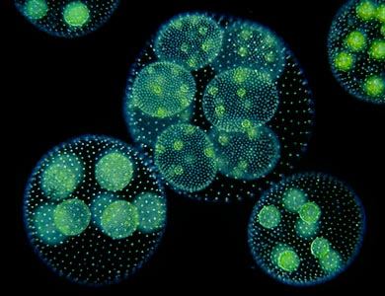
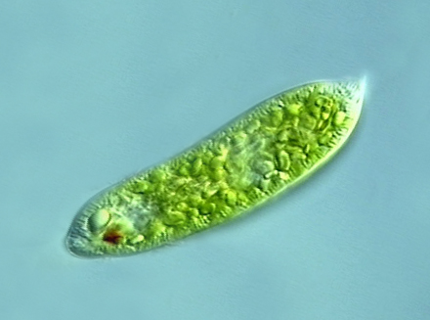
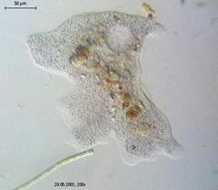
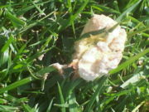
Kingdom Protista
Euglena - autotrophic
Volvox – a colonial protist
A slime mold
Amoeba - heterotrophic

Slide 16
Kingdom Fungi
Eukaryotic
Most are multicellular
Heterotrophic (decomposers)
Cell walls made of chitin

Slide 17
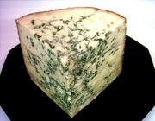
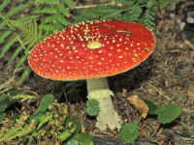
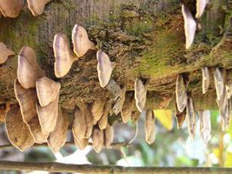
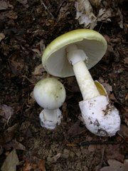
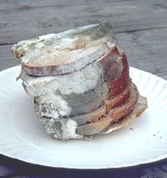
Kingdom Fungi
Stilton cheese
Bread mold

Slide 18
Kingdom Plantae
Eukaryotic
Multicellular
Autotrophic
Cell wall of cellulose; chloroplasts present

Slide 19
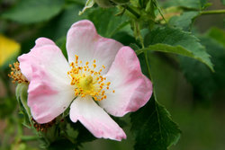
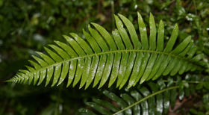
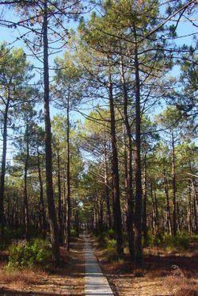
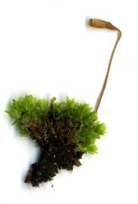
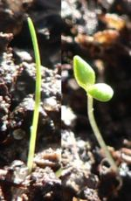
Kingdom Plantae

Slide 20
Kingdom Animalia
Eukaryotic
Multicellular
Heterotrophic
No cell walls, no chloroplasts

Slide 21
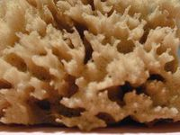
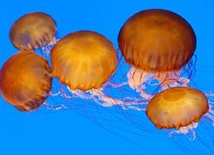
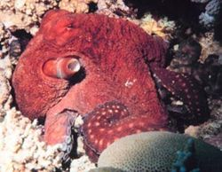
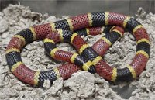
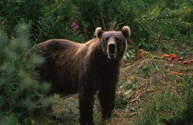
Kingdom Animalia
Flatworm
Sponge
Jellyfish
Octopus
Coral snake
Bear

