Slide 1
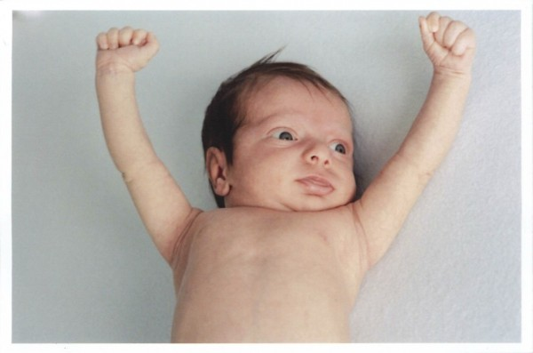
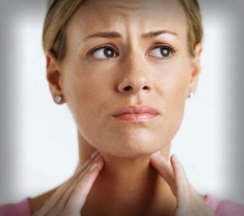
HYPOTHYROIDISM
By Anthony James

Slide 2
Symptoms
Fatigue, Pain, stiffness or swelling in your joints
Heavier than normal or irregular menstrual periods
Thinning hair,
Slowed heart rate
Depression
Impaired memory
Increased sensitivity to cold,
Constipation,
Dry skin,
Unexplained weight gain,
Puffy face,
Hoarseness,
Muscle weakness,
Elevated blood cholesterol level,
Muscle aches, tenderness and stiffness,

Slide 3
What happens when you have it
Although rare , hypothyroidism can occur in infants or children .If hypothyroidism is treated within the first month of life, a child will grow and develop normally. Untreated hypothyroidism in infants can cause brain damage, leading to intellectual disability. In the United States, all children are tested for hypothyroidism at birth.

Slide 4
How do you get it
Hypothyroidism may be caused by 1) an autoimmune disease that attacks the thyroid gland, 2) surgery or radiation to treat thyroid cancer and other conditions, or 3) rare and random genetic events in which a mutation is acquired during early development.

Slide 5
How is it treated or diagnosed
Hormone replacement therapy: people with hypothyroidism must take a synthetic form of thyroid hormone every day to reduce their symptoms. Babies are normally screened for hypothyroidism 24 hours after birth. A tiny sample of blood taken from the baby's heel is tested for low thyroid hormone levels or high thyroid-stimulating hormone (TSH) levels.

Slide 6
Interesting Facts
Hypothyroidism is an underactive thyroid gland is the most common thyroid disorder
Women over 50 are particularly susceptible to developing hypothyroidism.
There is no definitive way to prevent hypothyroidism.

Slide 7
Websites
http://www.mayoclinic.com/health/hypothyroidism/DS00353/DSECTION=symptoms
http://www.webmd.com/a-to-z-guides/hypothyroidism-what-happens
http://www.blueskymd.com/wp-content/uploads/2013/08/symptoms-of-hypothyroidism-in-women.jpg
http://netdna.celebritytoob.com/wp-content/uploads/2013/09/A41.jpg
http://learn.genetics.utah.edu/content/disorders/whataregd/hypothyroidism/index.html
http://www.endocrineweb.com/conditions/hypothyroidism/hypothyroidism-facts-tipshttp://
jeffreydach.com/2008/06/26/saving-tim-russert-and-george-carlin-by-jeffrey-dach-md.aspx
http://hypothyroidmom.com/wp-content/uploads/2012/10/Benjamin-copy-e1351093185119.jpg

Slide 8
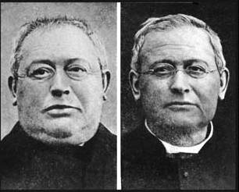
Before and After
This a before and after of someone who had hypothyroidism

