Slide 1
Huntington's disease
By: Kaila Cooper

Slide 2
What is it?
Huntington’s Disease s a brain disorder that affects a person’s ability to think, talk, and move.

Slide 3
What does this disease do?
Huntington’s disease destroys cells in the basic ganglia.
The ganglia is the part of the brain that controls movement, emotion, and cognitive ability.

Slide 4
What is Huntington’s Disease caused by?
Huntington’s disease is caused by a mutation in a gene on chromosome 4.

Slide 5
How do you get Huntington’s disease?
Huntington’s disease is inherited in an autosomal dominant pattern (a pattern of inheritance that requires only one affected parent to have the trait in order to pass it to their offspring).
Everyone who inherits the faulty gene will eventually get the disease.
A parent with the HD gene has a 50% chance of passing the disease on to their children.

Slide 6
Symptoms of HD
Most symptoms are seen around the ages of 30 and 50.
These symptoms include; uncontrolled movements, poor memory, depression, lack of coordination, twitching and difficulty walking, speaking, and/or swallowing.

Slide 7
Medications/ Treatments
Treatments do not show the progression of the disease, but can make the person with the disease feel more comfortable.
Medications can be used to ease the feelings of depression and anxiety, others can control involuntary movements.
Physical or speech therapy can help the Huntington’s Disease patients lead more normal lives.

Slide 8
Interesting facts
The disease Huntington’s Disease was named for Dr. George Huntington, who first described it in 1872.
In the US, about 1 in every 30,000 people have Huntington’s Disease.
This disorder was originally called Huntington’s Chorea, from the Greek word for dance.

Slide 9
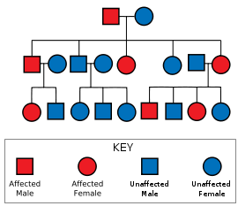
Huntington’s disease represented on a pedigree chart

Slide 10
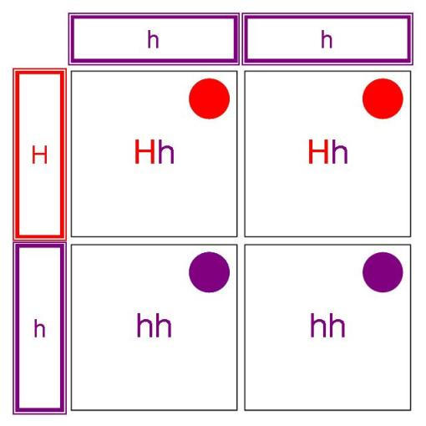
Punnett square representing Huntington’s Disease

Slide 11
The End!!

