Slide 1
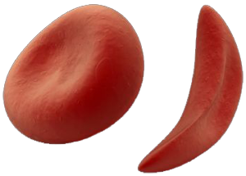
Genetics Project
Sickle Cell Disease

Slide 2
What is sickle cell disease?
Sickle cell disease is a disease that causes blood cells to mutate turning into a long inflexible sickle shape.
Regular blood cells are flexible so they can slip through blood vessels, but a sickle blood cell gets stuck and clogs the blood vessel.

Slide 3
Symptoms
Causes damage to organs such as spleen, liver, kidney, lungs, and heart.
Victims don’t live as long as people with healthy blood cells.
Delayed growth
Strokes
Jaundice

Slide 4
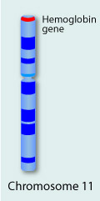
What does it affect?
People with this disease have a mutation in a gene on chromosome 11 causing a subunit of the hemoglobin protein.

Slide 5
How do people get it?
People get this disease through an autosomal recessive pattern, meaning both parents have a copy of the gene.

Slide 6
How is it treated?
At birth if it is not detected then doctors make test called hemoglobin electrophoresis.
Babies and children take a daily dose of penicillin to prevent infections and folic acid to provide healthy blood cells.

Slide 7
Fun Facts
Unlike regular healthy blood cells which live 120 days, sickle blood cells only live 20 days.
1 out of 500 African-American babies are born with sickle cell anemia.
Sickle cell disease is most common among people from Africa, India, the Caribbean, the Middle East, and the Mediterranean.

Slide 8
Citations
http://learn.genetics.utah.edu/content/disorders/whataregd/sicklecell/index.html

