Slide 1
Genetics Project
Colon Cancer

Slide 2
What is Colon Cancer?
When cancer develops in the cells lining the colon (large intestine) it is called Colon Cancer.

Slide 3
Symptoms
Diarrhea
Constipation
Vomiting
Bloating
Cramps
Blood in the stool
Unexpected weight loss

Slide 4
How is Colon Cancer Treated?
Colon cancer is only treatable if it has not spread very far around the body. The doctors see if it has spread. If the cancer has not spread to other tissues of the body it can be treated with.

Slide 5
How does it happen?
Colon Cancer happens when the cell growth stop working and cells divide out of control to form tumors.

Slide 6
How do you get Colon Cancer?
If a parent has FAP or HNPCC his or her children run a 50 percent risk of inheriting the mutated gene. The APC gene strikingly predisposes one to colon cancer. People who inherit a bad copy of the APC gene is guaranteed to develop colon cancer by age 40.

Slide 7
Facts on Colon Cancer!
Colon cancer is the third most commonly diagnosed cancer.
72% of cases arise in the colon and about 28% in the rectum.
lifetime risk of developing colon cancer is about one in 20.

Slide 8
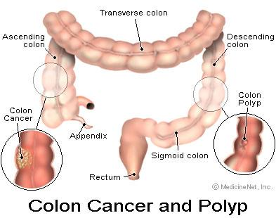
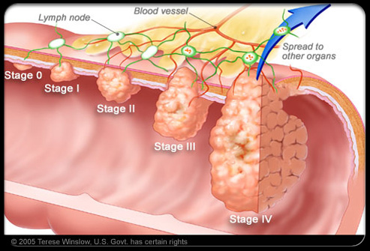
The End!

Slide 9
Citations
http://learn.genetics.utah.edu/content/disorders/whataregd/colon/index.html
https://www.ccalliance.org/colorectal_cancer/statistics.html

