Slide 1
Genetics Project
Colon Cancer
Colon Cancer-
When cancer develops in the cells lining the colon.

Slide 2
What are the Symptoms?
Colon cancer affects the stomach and bowels. The common symptoms are: diarrhea or constipation, blood in the stool, vomiting, bloating, cramps, and unexplained weight lose.

Slide 3
How does it happen?
It starts with the growth of polyps in the colon.
Polyp-The abnormal growth of tissue.
Over time the polyps get bigger.
Nests of malignant cells appear in the polyps.
If the polyp is not removed, some of these malignant cells will escape from the tumor and spread throughout the body.

Slide 4
How do people get it?
People who have a history of colon cancer in their family are at greater risk of getting the disease themselves.

Slide 5
How is it treated?
Colon cancer is very easy to treat. First, doctors see how far the cancer has progressed. If the cancer has not spread to other tissues, it can be treated with either:
special chemicals or surgery to remove the polyps

Slide 6
Interesting facts
Colon cancer is the third leading cause of cancer deaths in Delaware.
Colon cancer affects men and women of all ages, but people 50 years old or older are more likely to get colon cancer.
To prevent colon cancer, you can not smoke and maintain a healthy weight.

Slide 7
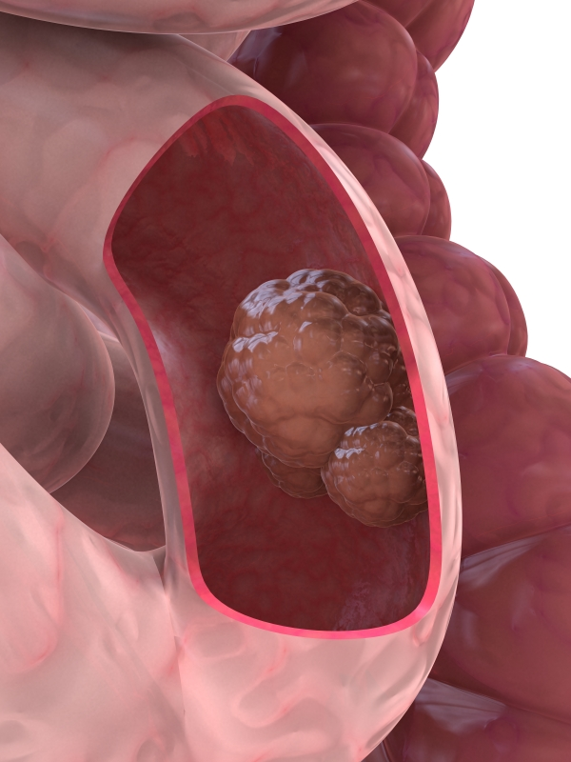
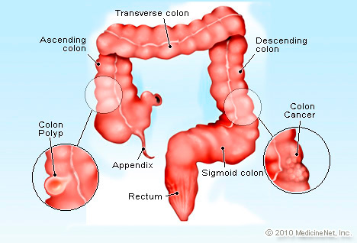
Photos
Polyp

