Slide 1
Down syndrome
By: Jordan hill

Slide 2
Affection/symptoms
Down syndrome effects include mental retardation, thyroid problems, and eye problems. There are lots of symptoms to down syndrome, which are: flat face, small nose, abnormally shaped ears, large tongue, also having trouble learning to walk and talk.

Slide 3
How it happens
Down syndrome happens because you develop an extra copy of chromosome 21.
this occurs in the mutation of multiple genes.
This happens in a level two.

Slide 4
How people get it
People get down syndrome by something that is called nondisjunction.

Slide 5
treatment
Doctors have stated that there is really no cure for the down syndrome disease.
physical therapy and speech therapy can help people with the disorder develop more normally than any other treatment.

Slide 6
interesting facts about this disease
Down syndrome is the most common genetic disorder caused by a chromosomal abnormality.
It affects 1 out of every 800 to 1,000 babies.
Down syndrome was originally described in 1866 by John Langdon Down.
Until 1959 a French doctor discovered that it was caused by an extra chromosome 21.

Slide 7
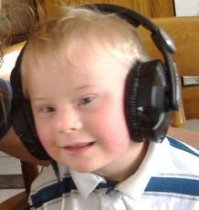
picture

Slide 8
