Slide 1
Down Syndrome
By Nathaniel Gillig

Slide 2
Symptoms of down syndrome
Short neck
Misshaped ears
Heart defects
Sight and hearing problems
Hearing loss
Heart defects
Sleep problems
Seizures
Slow growth
Speech problems
Obesity
Emotional problems

Slide 3
How you can get Down syndrome
Since a baby inherits genetic information from its parents in most cases of Down syndrome a child gets an extra chromosome 21 for 47 chromosomes instead of 46.
This extra chromosome causes the symptoms of Down syndrome.

Slide 4
How do you get down syndrome
Down syndrome occurs when part of chromosome 21 becomes attached to another chromosome.
The older the woman the higher chance of her child having Down syndrome.

Slide 5
Treatments for down syndrome
There is no known cure that we have found to Down syndrome.
The goals are to find a way to help prevent Down syndrome.

Slide 6
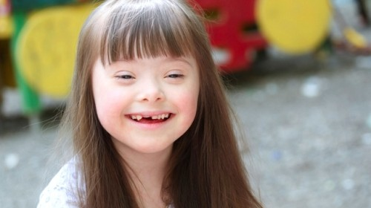
Pictures
This picture shows a girl that has Down syndrome.

Slide 7
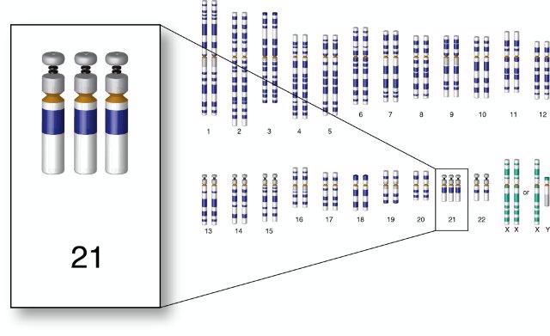
Picture
This picture shows all 23 chromosomes however enlarged is chromosome 21, the chromosome affected in Down syndrome.

Slide 8
Facts on Down syndrome
Down syndrome is the most common and identified chromosome condition associated with intellectual disabilities.
It affects about one out of 700-800 people.
Down syndrome is a level 2 disease meaning that large parts of the chromosome is missing or in this case much of the chromosome is attached to another chromosome.

Slide 9
Citations
http://www.medicalnewstoday.com/articles/145554.php
http://www.ndss.org/Down-Syndrome/What-Is-Down-Syndrome/
http://kidshealth.org/parent/medical/genetic/down_syndrome.html#
http://www.medicalnewstoday.com/articles/145554.php

