Slide 1
Cystic Fibrosis
By: Ruth Maureen Riggie

Slide 2
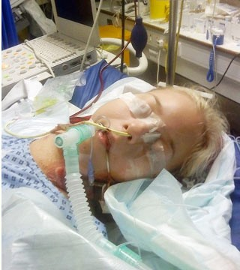
What is Cystic Fibrosis?
Cystic Fibrosis is a genetic disorder that causes problems for the Respiratory and Digestive systems.

Slide 3
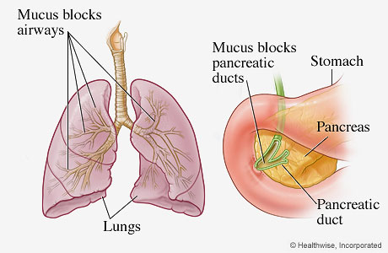
How does it affect you?
Cystic Fibrosis can affect how you digest food. A thick mucus can block the pancreas so digestive enzymes cant get to the intestines, so they can not digest food right. It can also affect how you grow, because you can't get proper nutrients.

Slide 4
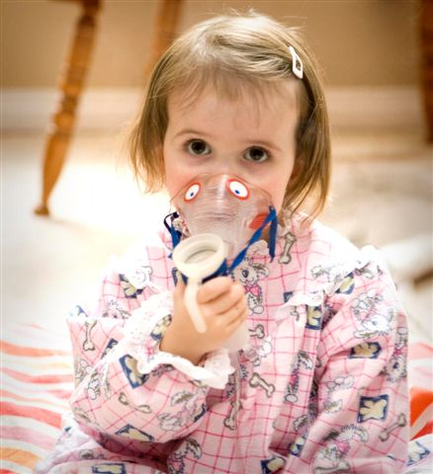
Symptoms of cystic Fibrosis
Symptoms may include but are not limited to salty tasting skin, greasy stool, weight loss, coughing and wheezing, and respiratory illness.

Slide 5
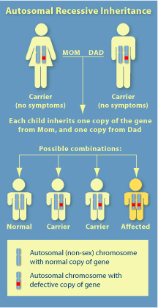
How do you get Cystic Fibrosis
Sadly you have no choice to get the disease. It is a recessive disorder meaning two parents must be a carrier for the disease in order for offspring to receive the disorder.

Slide 6
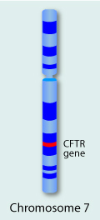
How does it Happen?
With Cystic Fibrosis you inherit a gene on your seventh chromosome (CFTR). This protein in this gene helps move salt in and out of cells.

Slide 7
How is it Treated?
Cystic Fibrosis can not be cured but it cam be treated. Treatments include but are not limited to chest therapy, inhaled antibiotics, and gene therapy.

Slide 8
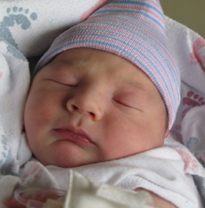
Interesting Facts
More than 2500 children are born with Cystic Fibrosis
Over 1 million people are born with the carrier for Cystic Fibrosis but do not realize it
More than 1000 different mutations of the disease have been discovered

Slide 9
Citations
http://mrsmorganssciencepage.weebly.com/7th-advanced.html
http://learn.genetics.utah.edu/content/disorders/whataregd/cf/index.html
http://images.google.com/

