Slide 1
Alzheimer's disease
By: Angelyn Johnson

Slide 2
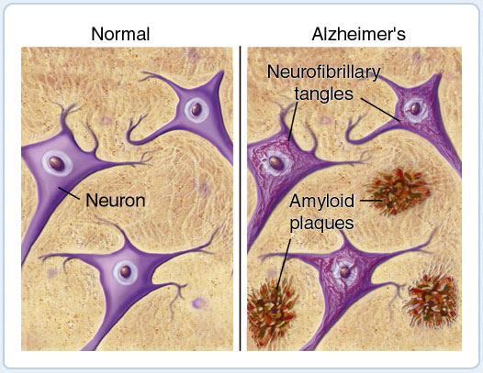
What does it affect?
What Alzheimer’s disease affects is the organ called the brain.
It destroys the brain cells.
It affected about 4 million people in this world.
This is picture of the neuron that is not affected and one that is affected and has plaques.

Slide 3
What are the symptoms?
The symptoms of Alzheimer’s are:
Forgetting words or phrases
Trouble finding things
May forget how to do things such as driving and brushing hair

Slide 4
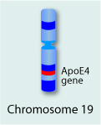
How does it happen, in single genes, multiple genes or chromosomes? Level 1, 2 or 3
It happens in chromosomes. To be exact it starts in chromosome 19.
This is a level 3.
This is a picture of chromosome 19 and the gene that has been affected with Alzheimer’s

Slide 5
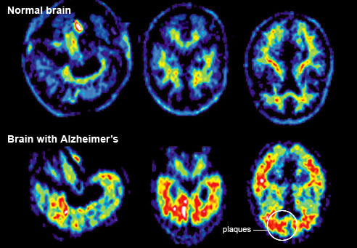
How do people get it?
People get Alzheimer's disease is that scientists believe that it is a combinations of genes and environmental factors. The scientists are not completely sure if that is what it is.
This is picture of the comparison of a brain and a brain with Alzheimer’s.

Slide 6
How is it treated?
It is treated by medicine because it slows the symptoms.
Also by people getting a caregiver to help them.
There is no possible way to cure Alzheimer’s.

Slide 7
How is it diagnosed?
It is diagnosed by doing tests such as patients memory, language skills, and their solving abilities.

Slide 8
Citations
"Alzheimer's Disease." Alzheimers disease. 383 Colorow Dr, Salt Lake City, Utah 84108, n.d. Web. 5 Dec. 2012. <http://learn.genetics.utah.edu/content/ disorders/whataregd/alzheimers/index.html>.

Slide 9
Interesting facts
My grandmother has been affected with Alzheimer’s disease.
It strikes at the age 65.
There is no actual test for the disease Alzheimer’s. But there is multiple tests to see if the person has Alzheimer’s.

