Slide 1
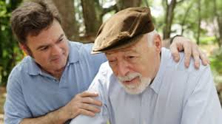
Alzheimer's Disease
By Isaiah Goldsmith

Slide 2
What is my genetic disorder?
My genetic disorder is Alzheimer's Disease.
Alzheimer's is a disease that causes dementia, or loss of brain function.
It affects the parts of the brain that deal with memory, thought, and language.

Slide 3
Symptoms.
Having trouble finding things.
Forgetting words or names.
They may forget how to do simple tasks (such as walking to a friend's house or brushing their hair).
People with Alzheimer's also feel nervous or sad.

Slide 4
How does it happen?
The forms of Alzheimer's are inherited in an autosomal dominant pattern, that means that one parent has to pass down a copy of the gene for their child to get Alzheimer's.

Slide 5
How do people get this?
Scientists don't know exactly how people get Alzheimer's, but they believe it is caused by a combination of genes and environmental factors (multifactorial disorder).

Slide 6
How is it treated?
There is no one test for Alzheimer's. Doctors use some different tests to check a persons memory, language skills, and problem solving abilities. These tests don't diagnose Alzheimer's, but they can rule out other disorders that have similar symptoms.
People with Alzheimer's have caregivers (people who help them do things they cant)

Slide 7
Interesting facts!
Alzheimer's was named after the German doctor, Alois Alzheimer, who named the disorder in 1906.
The older a person gets, the higher his or her risk of getting Alzheimer's.
As many as 4 million Americans have Alzheimer's disease.

