Slide 1
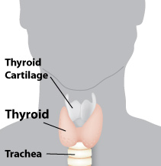
Hypothyroidism
By Adrian Lewis

Slide 2
What is Hypothyriodism?
Hypothyroidism (underactive thyroid) is a condition in which your thyroid gland doesn't produce enough of certain important hormones and it gets bigger.

Slide 3
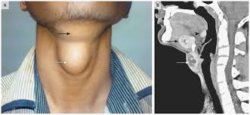
The symptoms and affects
hypothyroidism can cause a number of health problems, such as obesity, joint pain, infertility, heart disease, and large neck swelling.

Slide 4
How does it happen?
Hypothyroidism is a level 3, this means that it is very dangerous.
One thing that causes hypothyroidism is Hashimoto’s disease
Hashimoto’s disease is a form of chronic inflammation of the thyroid gland.
It happens in multiple chromosomes

Slide 5
How do you treat it?
Hypothyroidism can be easily treated using thyroid hormone medicine. The most effective and reliable thyroid replacement hormone is man-made (synthetic).

Slide 6
Fun Facts
Women over 50 are particularly susceptible to developing hypothyroidism
Hypothyroidism—an underactive thyroid gland—is the most common thyroid disorder.
Synthetic thyroid supplements are the preferred treatment for hypothyroidism today.

Slide 7
Citations
http://www.mayoclinic.com
http://www.medicinenet.com
http://learn.genetics.utah.edu
http://www.endocrine.niddk.nih.gov
http://www.webmd.com
http://www.endocrineweb.com

