Slide 1
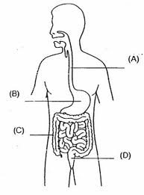
Name 7 Advanced Digestive Quiz
Identify the Letter or letters that best matches the question or statement
Mouth
Rectum
Large Intestine
Small Intestine
Stomach
Location of Chemical Digestion
Location of Peristalsis
Organ responsible for the removal of water from waste
Esophagus
A
B
C
D
E
F

Slide 2
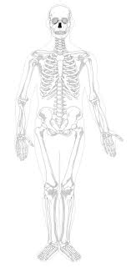
Name 7 Human Body Quiz 1
10. Color the axial skeleton on the diagram
11. Color the appendicular skeleton blue on the diagram
12. Circle a hinge joint with green on the diagram
13. Draw an orange arrow pointing to a ball and socket joint
14. Name two functions of the skeletal system
15. Name the three types of muscle
16. For each type of muscle, give an example of where it is located.

Slide 3
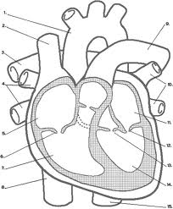
8.
2.
5.
6. VALVE
7.
9&3
TO THE LUNGS - PICK UP Oxygen
4 &10
11.
12. VALVE
14.
13.VALVE
1.
15.

